Slide 1
Object to Relational Mapping:
Django ORM
Dr. Shaheen Khatoon
Application
program
DBMS
End-user
1-<number>

Slide 2
How to install Django
Separate Virtual Environment
Globally

Slide 3
Django Requirements
Python 3.0 or Higher
python --version
PIP
pip --version
Text/Code Editor/IDE – Notepad++, VS Code, ATOM, PyCharm
Web Browser – Google Chrome, Mozilla Firefox, Edge

Slide 4
Check Django is installed or Not
django-admin --version

Slide 5
How to Install Django
pip install django – This is used to install Django.
For Version Specific
pip install django==2.0

Slide 6
How to Uninstall Django
pip uninstall django

Slide 7
Django Project
A Django Project may contain multiple Project Application, which means a group of Application and files is called as Django Project.
An Application is a Part of Django Project.
SchoolProject
  Registration App
  Fees App
  Exam App
  Attendance App
  Result App

Slide 8
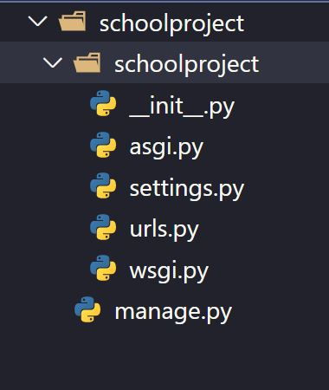
Create Django Project
Syntax: -
django-admin startproject projectname
Example:-
django-admin startproject schoolproject
schoolproject
schoolproject
__init__.py
asgi.py
settings.py
urls.py
wsgi.py
manage.py

Slide 9
Django Project Directory Structure
SchoolProject
SchoolProject
__init__.py
asgi.py
settings.py
urls.py
wsgi.py
manage.py
Outer Project Folder/Root Directory
Inner Project Folder

Slide 10
Django Project Directory Structure
__init__.py – The folder which contains __init__.py file is considered as python package.
wsgi.py – WSGI (Web Server Gateway Interface) is a specification that describes how a web server communicates with web applications, and how web applications can be chained together to process one request. WSGI provided a standard for synchronous Python apps.
asgi.py – ASGI (Asynchronous Server Gateway Interface) is a spiritual successor to WSGI, intended to provide a standard interface between async-capable Python web servers, frameworks, and applications. ASGI provides standard for both asynchronous and synchronous apps (Provide interface for web application and web server)
settings.py – This file contains all the information or data about project settings.
E.g.:- Database Config information, Template, Installed Application, Validators etc.
urls.py – This file contains information of url attached with application.
manage.py – manage.py is automatically created in each Django project. It is Django’s command-line utility also sets the DJANGO_SETTINGS_MODULE environment variable so that it points to your project’s settings.py file. Generally, when working on a single Django project, it’s easier to use manage.py than django-admin.

Slide 11
How to run server
Django provides built-in server which we can use to run our project.
runserver – This command is used to run built-in server of Django.
Steps:-
Go to Project Folder
Then run command python manage.py runserver
Server Started
Visit http://127.0.0.1:8000 or http://localhost:8000
You can specify Port number python manage.py runserver 5555
Visit http://127.0.0.1:5555 or http://localhost:5555

Slide 12
How to Stop server
ctrl + c is used to stop Server
Note – Sometime when you make changes in your project you may need to restart the server.

Slide 13
How to Start/Create Application
A Django project contains one or more applications which means we create application inside Project Folder.
Syntax:- python manage.py startapp appname
Creating One Application inside Project:-
Go to Project Folder
Run Command python manage.py startapp course
Creating Multiple Applications inside Project:-
Go to Project Folder
python manage.py startapp course
python manage.py startapp fees
python manage.py startapp result

Slide 14
How to Install Application in Our Project
As we know a Django project can contain multiple application so just creating application inside a project is not enough we also have to install application in our project.
We install application in our project using settings.py file.
settings.py file is available at Project Level which means we can install all the application of project.
This is compulsory otherwise Application won’t be recognized by Django.
Open settings.py file
INSTALLED_APPS = [
‘django.contrib.admin’,
‘application_name1’,
‘application_name2’,
]
Save settings.py File
INSTALLED_APPS = [
‘django.contrib.admin’,
‘course’,
‘fees’,
‘result’,
]

Slide 15
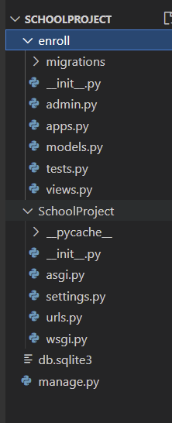
Steps in our Project
Create Django Project: django-admin startproject SchoolProject
Change Directory to Django Project: cd SchoolProject
Create Django Application: python manage.py startapp enroll
Add/Install Application to Django Project (enroll to SchoolProject)
  Open settings.py
  Add enroll
  INSTALLED_APPS = [‘django.contrib.admin’,‘course’, ]
  Save settings.py

Slide 16
Application Directory Structure
Go to Project Folder
Run Command python manage.py startapp enroll
enroll
migrations
__init__.py
__init__.py
admin.py
apps.py
models.py
tests.py
views.py

Slide 17
Application Directory Structure
migrations – This folder contains __init__.py file which means it’s a python package. It also contains all files which are created after running makemigration command .
__init__.py – The folder which contains __init__.py file is considered as Python Package.
admin.py – This file is used to register sql tables so we could perform CRUD operation from Admin Application. Admin Application is provided by Django to perform CRUD operation.
apps.py – This file is used to config app.
models.py – This file is used to create our own model class later these classes will be converted into database table by Django for our application.
tests.py – This is files is used to create tests.
views.py – This file is used to create view. We write all the business logic related code in this file.

Slide 18
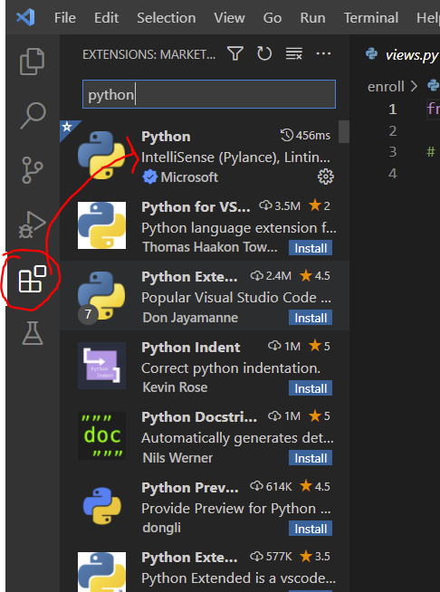
Note for Python support in Visual Studio Code (VSC)
To get support of Python in VSC please install python package in VSC
Go to package icon at the left panel.
Type Python and click install
1-<number>

Slide 19
Object Relational Mapper (ORM)
Object-Relational Mapper (ORM), which enables application to interact with database such as SQLite, MySQL, PostgreSQL, Oracle.
ORMs automatically create a database schema from defined classes or models. It generate SQL from Python code for a particular database which means developer do not need to write SQL Code.
ORM maps objects attributes to respective table fields.
It is easier to change the database if we use ORMs hence project becomes more portable.
Django's ORM is just a way to create SQL to query and manipulate your database and get results in a pythonic fashion.
ORMs use connectors to connect databases with a web application.

Slide 20
Object Relation Mapper (ORM)
Application
Database

Slide 21
Object Relation Mapper (ORM)
CREATE TABLE "enroll_student" (
"id" integer NOT NULL PRIMARY KEY AUTOINCREMENT,
"stuid" integer NOT NULL,
"stuname" varchar(70) NOT NULL,
"stuemail" varchar(70) NOT NULL,
"stupass" varchar(70) NOT NULL
);
class Student(models.Model):
stuid=models.IntegerField()
stuname=models.CharField(max_length=70)
stuemail=models.EmailField(max_length=70)
stupass=models.CharField(max_length=70)
id | stuid | stuname | stuemail | stupass

Slide 22
QuerySet
A QuerySet can be defined as a list containing all those objects we have created using the Django model.
QuerySets allow you to read the data from the database, filter it and order it.

Slide 23
Model
A model is the single, definitive source of information about your data.
It contains the essential fields and behaviors of the data you’re storing.
Generally, each model maps to a single database table.

Slide 24
Model Class
Model class is a class which will represent a table in database.
Each model is a Python class that subclasses django.db.models.Model
Each attribute of the model represents a database field.
With all of this, Django gives you an automatically-generated database-access API Django provides built-in database by default that is sqlite database.
We can use other database like MySQL, Oracle SQL etc.

Slide 25
Create Our Own Model Class
models.py file which is inside application folder, is required to create our own model class.
Our own model class will inherit Python’s Model Class.
Syntax:-
class ClassName(models.Model):
field_name=models.FieldType(arg, options)
Example:-
models.py
class Student(models.Model):
stuid=models.IntegerField()
stuname=models.CharField(max_length=70)
stuemail=models.EmailField(max_length=70)
stupass=models.CharField(max_length=70)
Length is required in CharField Type
This class will create a table with columns and their data types
Table Name will be ApplicationName_ClassName, in this case it will be enroll_student
Field name will become table’s Column Name, in this case it will be stuid, stuname, stuemail, stupass with their data type.
As we have not mentioned primary key in any of these columns so it will automatically create a new column named ‘id’ Data Type Integer with primary key and auto increment.

Slide 26
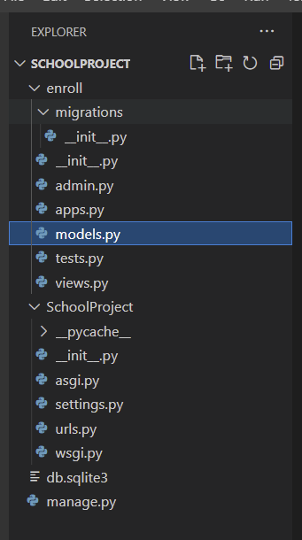
Create Our Own Model Class
models.py
class Student(models.Model):
stuid=models.IntegerField()
stuname=models.CharField(max_length=70)
stuemail=models.EmailField(max_length=70)
stupass=models.CharField(max_length=70)
CREATE TABLE "enroll_student" (
"id" integer NOT NULL PRIMARY KEY AUTOINCREMENT,
"stuid" integer NOT NULL,
"stuname" varchar(70) NOT NULL,
"stuemail" varchar(70) NOT NULL,
"stupass" varchar(70) NOT NULL
);

Slide 27
Rules
Field Name instantiated as a class attribute and represents a particular table’s Column name.
Field Type is also known as Data Type.
A field name cannot be a Python reserved word, because that would result in a Python syntax error.
A field name cannot contain more than one underscore in a row, due to the way Django’s query lookup syntax works.
A field name cannot end with an underscore.

Slide 28
Migrations
Migrations are Django’s way of propagating changes you make to your models (adding a field, deleting a model, etc.) into your database schema.
makemigrations – This is responsible for creating new migrations based on the changes you have made to your models.
migrate – This is responsible for applying and unapplying migrations.
sqlmigrate – This displays the SQL statements for a migration.
showmigrations – This lists a project’s migrations and their status.

Slide 29
makemigrations and migrate
makemigrations is used convert model class into sql statements. This will also create a file which will contain sql statements. This file is located in Application’s migrations folder.
Syntax:- python manage.py makemigrations
migrate is used to execute sql statements generated by makemigrations. This command will execute All Application’s (including built-in applications) SQL Statements if available. After execution of sql statements table will be created.
Syntax:- python manage.py migrate
Note – If you make any change in your own model class you are required to run makemigrations and migrate command only then you will get those changes in your application.

Slide 30
Display SQL Statement
We can retrieve SQL Statement by using below command:-
Syntax:-
python manage.py sqlmigrate application_name dbfile_name
Example:-
python manage.py sqlmigrate enroll 0001
Note – File name can be found inside Application’s migrations folder.

Slide 31
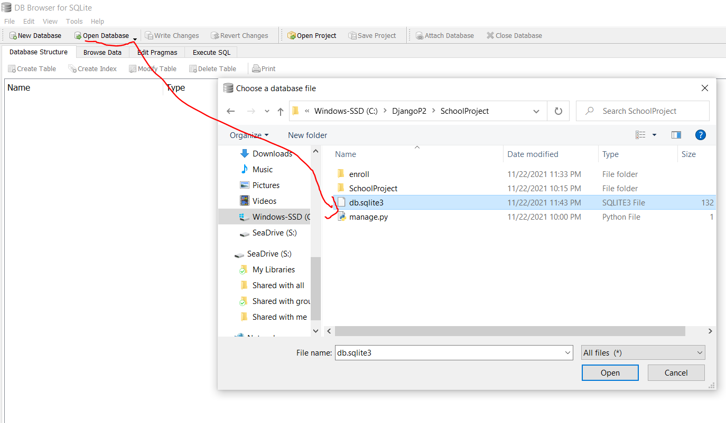
Verify tables in SQLite
Open sqlite
Open database by locating the Django project folder
1-<number>

Slide 32
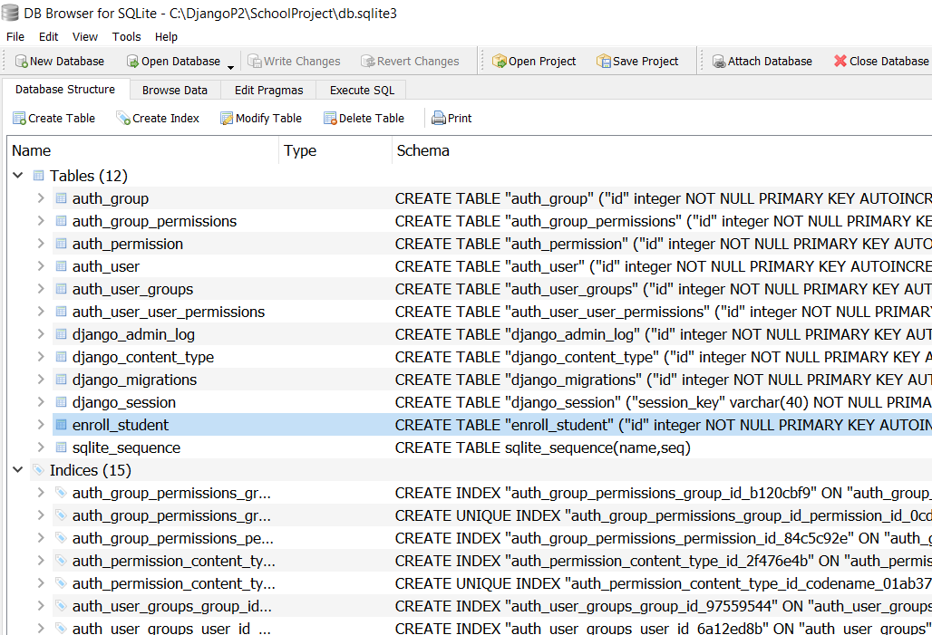

1-<number>

Slide 33
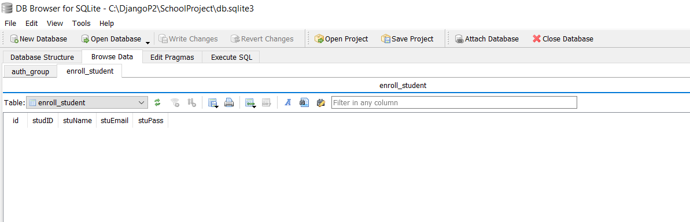
Right click enroll_student table and select browse:
1-<number>

Slide 34
Lab Assignment: ORM for Online Course APP
1
User
first_name: string last_name: string dob: Date
Inheritance (One-To-One
1
Inheritance (One-To-One
1
1
Course
name: string description: string instructors: set Learners: set
Learner
occupation: string social_link: url
Instructor
Is_full_time: Boolean total_learners: string
1..*
1..*
1..*
1..*
Many-To-Many
Many-To-Many
1
1..*
Many-To-One
Lesson
title: string course: course content: TextField()

